Slide 1
Bridge Scour Mitigation Using Concrete Armor Units 25-Years of Performance
Daniel J. Priest, P.E.
Notes:
Dan Priest – Contech Engineered Solutions
25-years of Bridge Scour Mitigation

Slide 2
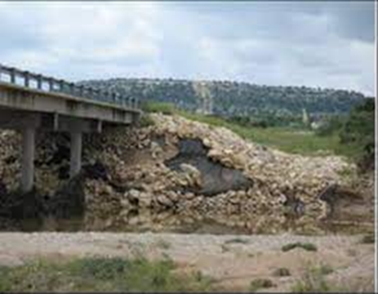
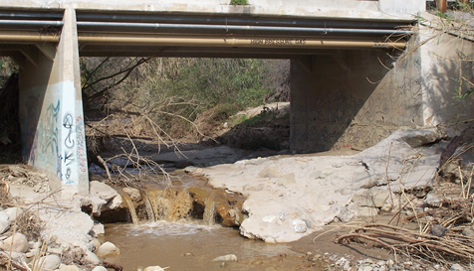
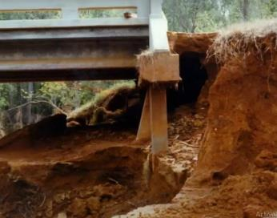
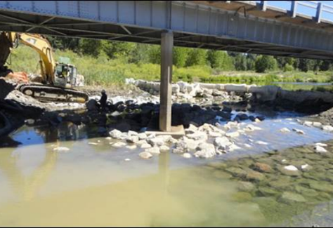
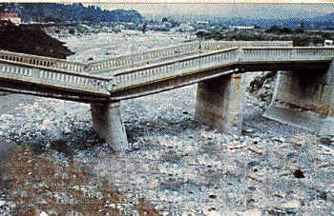
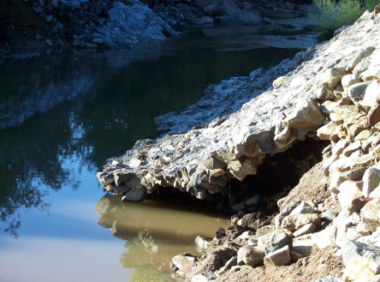
Bridge Scour – The Issues
Notes:
Scour around abutments and piers
But as a permanent solution instead of the traditional temporary solution provided by rock riprap

Slide 3
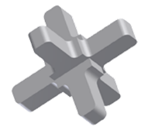
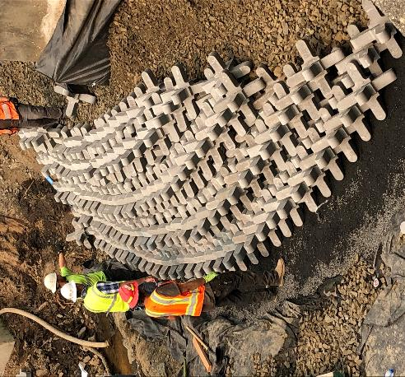
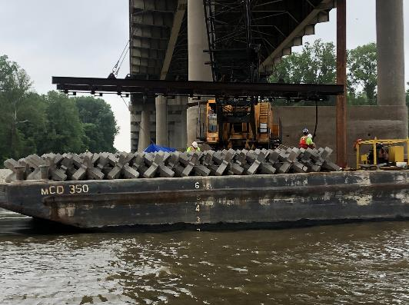
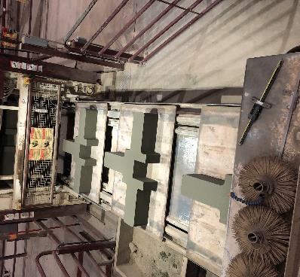
A-Jacks Concrete Armor Units
Premanufactured Concrete Units
Interlocking, high stability armoring unit
Hand Placed or Bundled Placement
Extensive Testing
Notes:
manufacturing 35 years
Coastal wave attack protection
Now riverine scour issues.
Units are precast concrete
Easy to install to align with planned channel geometries
Hand placed or bundle placement
Bundles allow for placement without dewatering

Slide 4
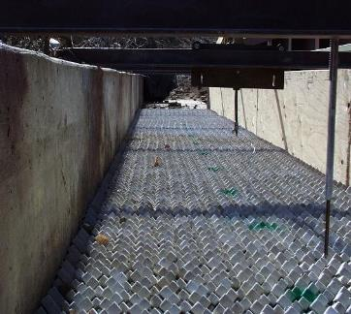
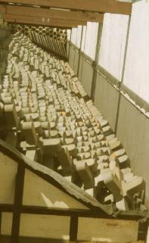
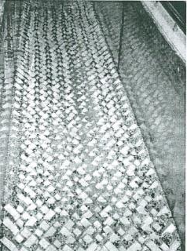
Testing & Performance
Coastal/Wave Impact & Attenuation – Oregon State University
Finite Element Analysis – Auburn University
Structural – University of Florida
Hydraulic Testing – Colorado State University
Notes:
Testing = acceptance
Determine hydraulic limits
Used major universities across country

Slide 5
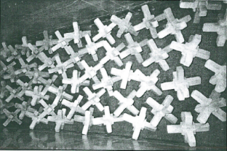
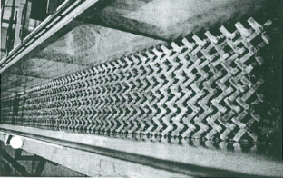
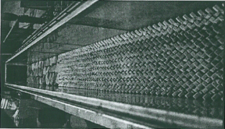
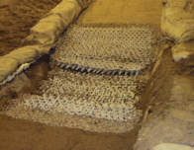
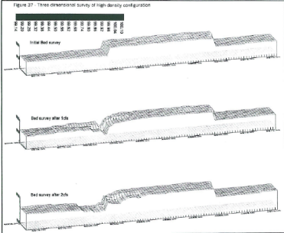
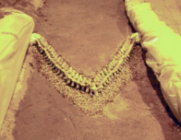
CSU Hydraulic Testing
Hydraulic properties
Matrix stability
Manning’s n
Without sediment
With sediment
Headcut mitigation
Notes:
CSU testing started with stability of the units – scattered placement, medium placement, and tight placement to determine velocity and shear stress limits
Roughness big question – for same configurations, with sediment latent flow and without in those installations in a steady state flow regime
Scour and head cut mitigation for evaluation of drop structures, instream flow control structures, alphabet weirs, and other channel restoration applications

Slide 6
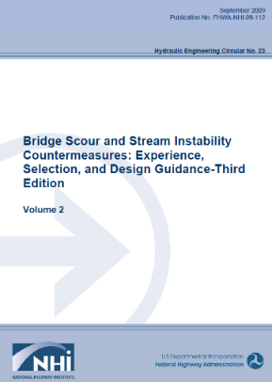
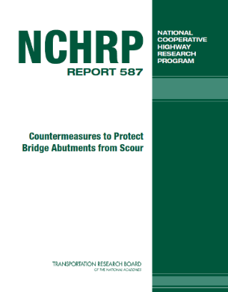
Design Guidance
Design Guidance
Pier Scour
Abutment Scour
Channel Lining
Grade Control
Energy Dissipation
Contech Pier Scour
Design Guide
Contech Abutment Scour
Design Guide
Notes:
Testing basis for design guides
Dozens scour tests
HEC-23 Design Guide
Contech simple DG

Slide 7
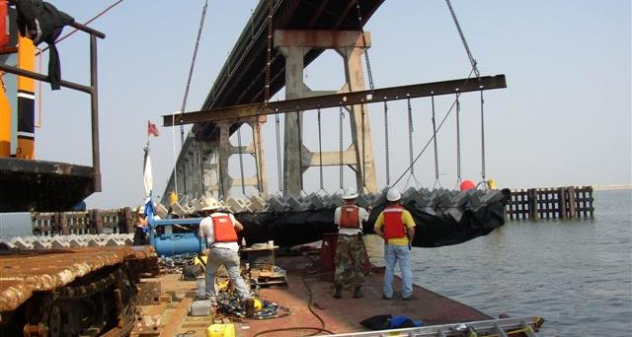
Project Applications
Notes:
Installs
3 on poster
AASHTO President’s Award Winner
Mississippi River project – carbon footprint analysis
Hurricane tested site in NJ
Today, a little different flavors

Slide 8
NHDOT Covered Historical Bridges
Sawyers Crossing aka Cresson Bridge
Notes:
Start in the Northeast in NH.
NHDOT preserve covered bridge structures
1800s more than 300 covered bridges
Today, around 50 remain.
This is the Cresson Bridge built in 1859 at a cost of $1800
117-ft long and 17-ft wide
Split granite center pier

Slide 9
NHDOT Covered Historical Bridges
Notes:
2017 Pier Protection updated with A-Jacks surrounding 11-ft in all directions.
Eliminated the need for annual riprap replacement and removing heavy loaded trucks from the sensitive roadway.

Slide 10
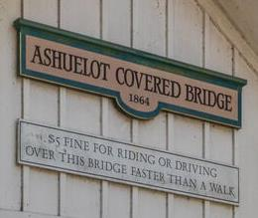
NHDOT Covered Historical Bridges
Gunn Mountain Rd aka Ashuelot Covered Bridge
Notes:
Another structure the Ashuelot Bridge
Built in 1864 for $4,650
178 x 29 feet
central roadway and sidewalks on each side
Don’t run!

Slide 11
NHDOT Covered Historical Bridges
Notes:
Similar pier protection with A-Jacks completed in 2017
Annual Bridge inspection reports for both bridges confirm that the A-Jacks are in place and performing as designed.
NHDOT reports zero maintenance required over the last 7 years.

Slide 12
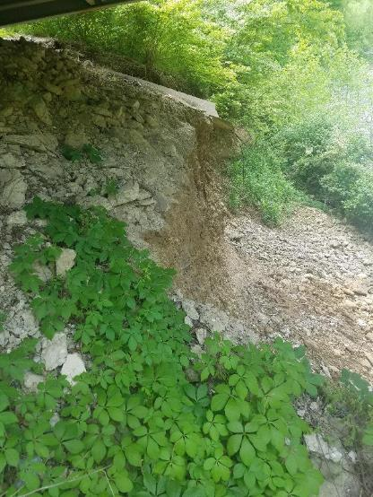
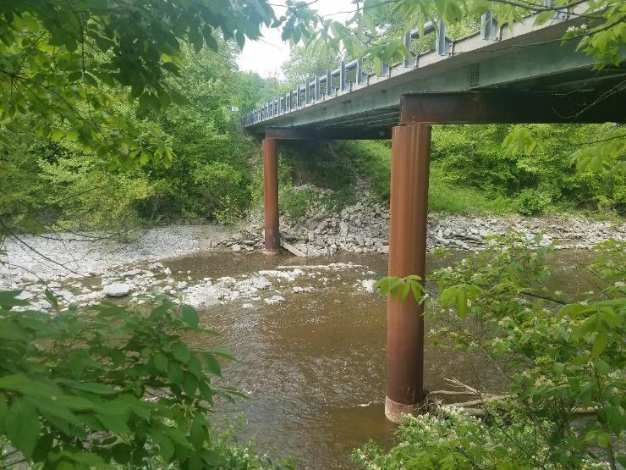
ODOT BRO 221 Bridge Life Extension
Notes:
Built in 1948
Single-span with steel pier caps.
Streamstats model averaging 23-fps with isolated exceeding 25-fps.
Over just a couple of year, scoured approximately 16 feet
Bridge not scheduled for replacement for several years.
Needed a stop gap

Slide 13
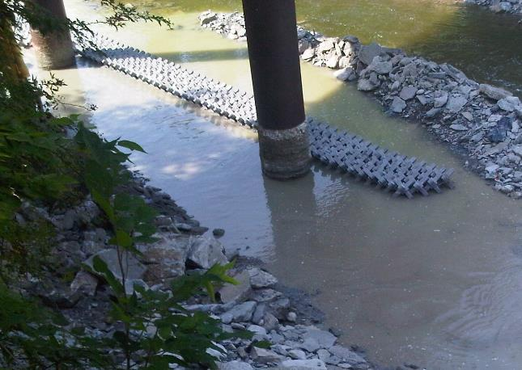
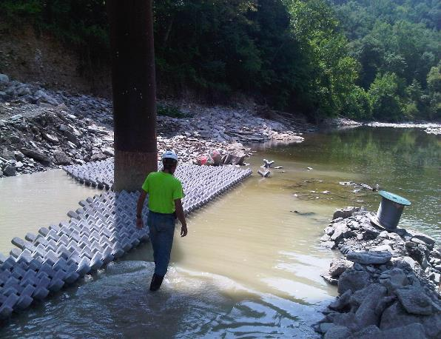
ODOT BRO 221 Bridge Life Extension
Notes:
In 2010, ODOT installed A-Jacks around the piers and at the base of the abutment to prevent against any further scouring.

Slide 14
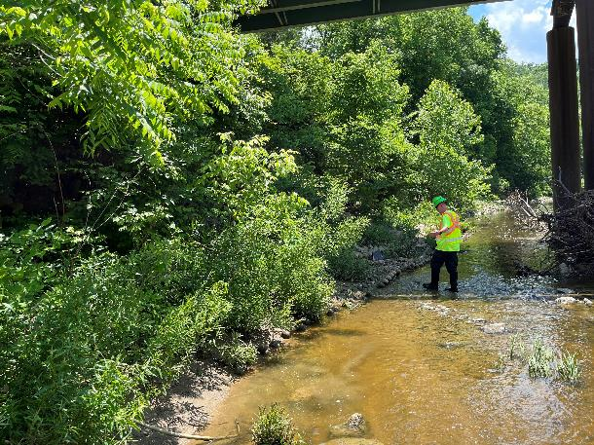
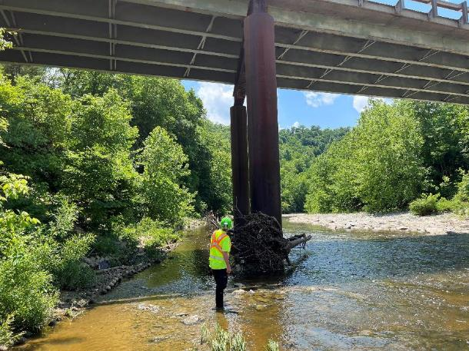
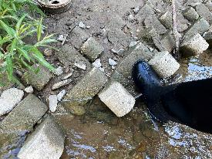
ODOT BRO 221 Bridge Life Extension
Notes:
Replaced in 2022
Inspection reports showed no further scouring around piers.
A-Jacks successfully allowed delay until funding appropriated.

Slide 15
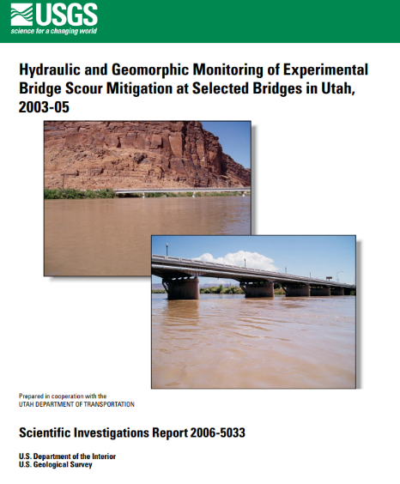
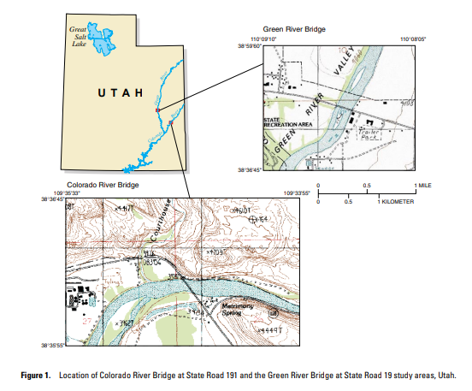
SR 191 & SR19- UT
Notes:
UT – Green River and Colorado River
Installation in 2003-2004
USGS and Utah DOT followed that up with a study

Slide 16
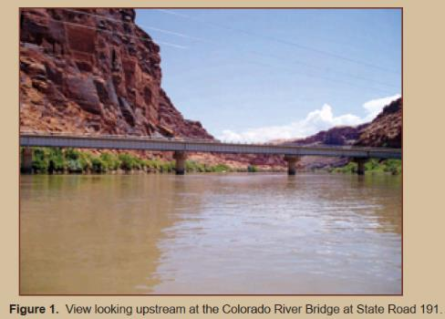
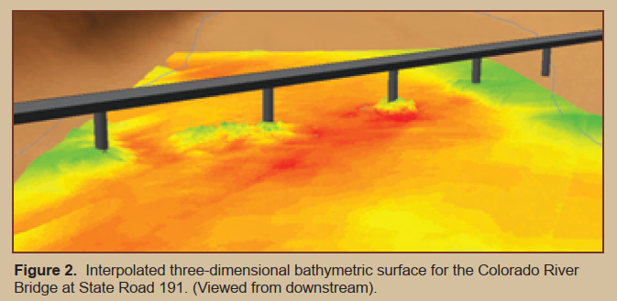
SR 191
Notes:
This is the 191 bridge near Moab
8 spans
Lateral migration of the Colorado River
Discharging mostly through 4 openings.

Slide 17
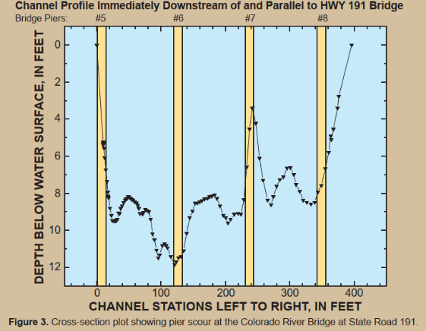
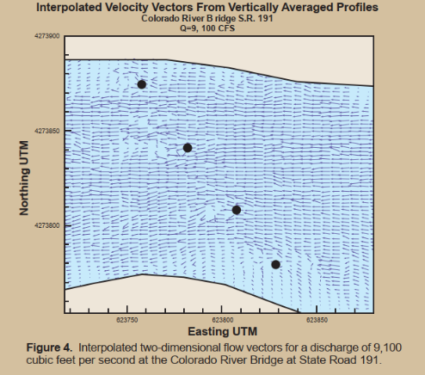
SR 191
Notes:
Bathometric Survery Piers 6 & 7 were experiencing significant scour
Potential issue on the horizon

Slide 18
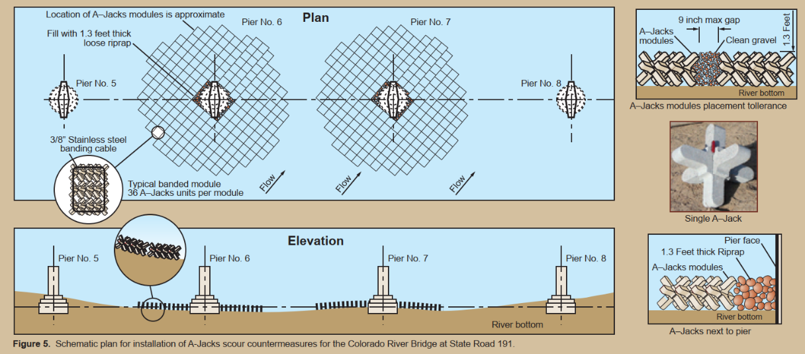
SR 191 & SR19- UT
Notes:
Bundles of A-Jacks
Deployed from barges

Slide 19
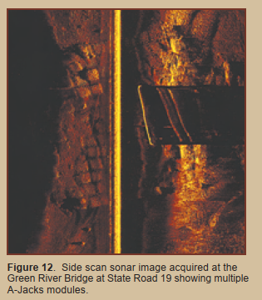
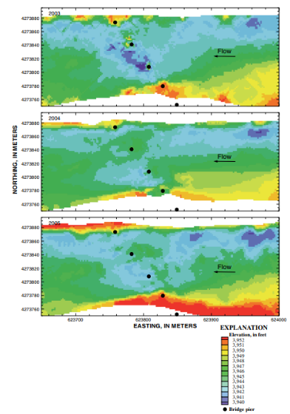
SR 191 & SR19- UT
Results:
SR 191
Increase in bed elevation at installation location
SR 19
Stabilization of bed elevation at installation location
Notes:
2006 Sonar
Verified installation of A-Jacks working
Similar story for SR19 – bed elevation around piers is stabilized

Slide 20
Pleasant Valley Road – Lewis Co, WA
Notes:
Lewis county WA small bridge structure experiencing issues with abutment scour.

Slide 21
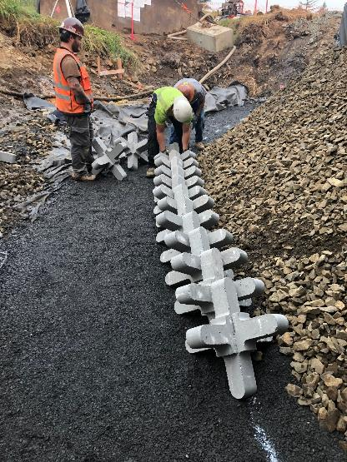
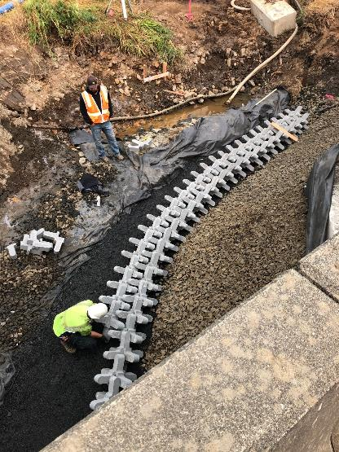
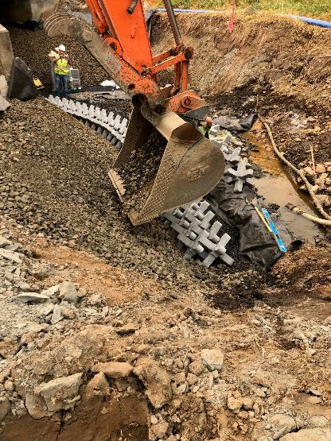
Pleasant Valley Road – Lewis Co, WA
Notes:
Pallets of 24” A-Jacks staged on site and then lowered into the dewatered excavation.
Installed on top of a prepared foundation at the toe of the slope.
From an installation perspective, the first row was installed at the toe following the planned stream alignment and then an additional row was installed on the water side.
Stone backfill was used to bring up the tiered alignment.

Slide 22
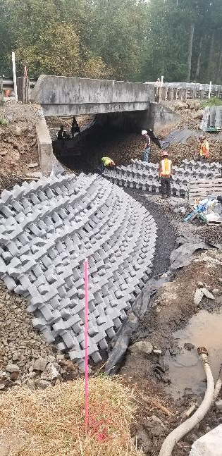
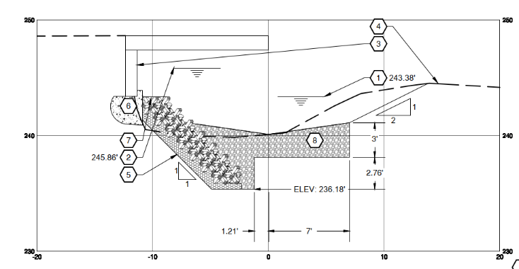
Pleasant Valley Road – Lewis Co, WA
Notes:
As you can see from the drawing on the left, we had 2 rows that were staggered up the embankment much like stairs at a 1:1 slope.
This is a salmon bearing stream, so fish rock was incorporated into the backfill to re-establish the bed of the stream.

Slide 23
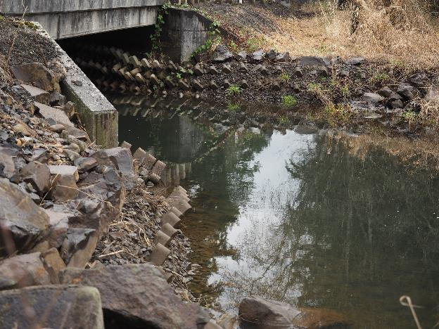
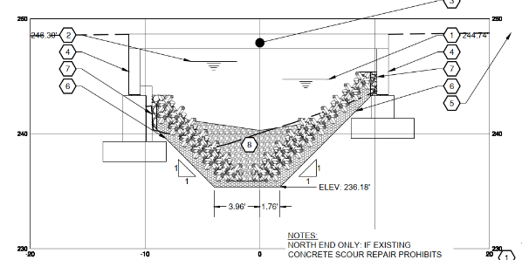
Pleasant Valley Road – Lewis Co, WA
Notes:
Installed below scour depth and at an elevation to provide long-term protection to the shallow spread footings
Great project, contractor was able to about 1500 units per day.

Slide 24
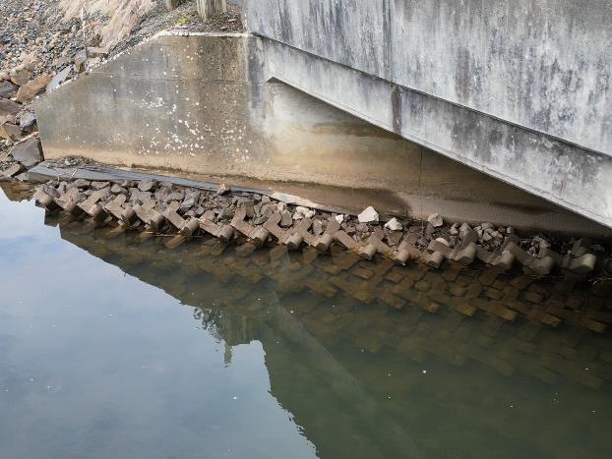
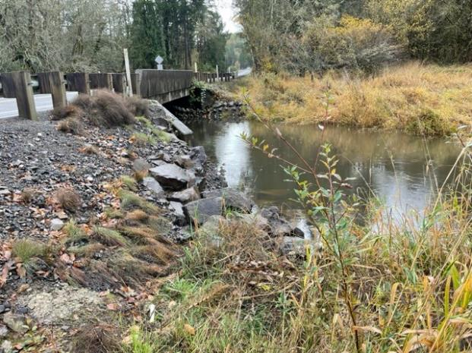
Pleasant Valley Road – Lewis Co, WA
Notes:
And over time, vegetation has started to return nicely while the repairs are providing good passage for salmon and protection for the abutments.

Slide 25
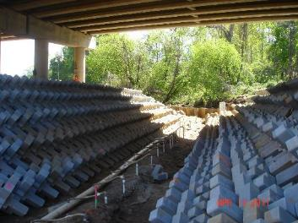
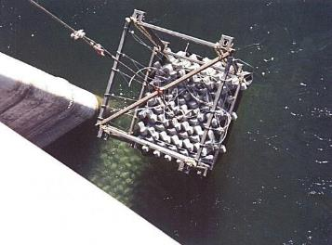
Notes:
A-Jack applications more than just bridge piers and abutments
- Contraction scour
- Pipe outlets
- slope protection
- weir structures
- grade control
- energy dissipation

Slide 26
Contact
Dan Priest, PE
Contech Engineered Solutions
Dan.Priest@ContechES.com
For more information on A-Jacks
Notes:
Please stop by tomorrow morning to see our poster
QR code link to our website for more information including the prior referenced DGs.

